Slide 1
Azure Networking Overview
Notes:
IMPORTANT NOTE:
Microsoft Ready will utilize Windows 10 and the new PowerPoint 2016, as well as PowerPoint 2013 on all event machines. Please build your slides utilizing the appropriate Template and utilize the version of PowerPoint that works best.
Windows 10 devices now connect remotely through VPN using the PIN with Passport for Work. Speakers needing to use VPN in a demo, will need to have registered for Phone Authentication at https://phoneregistration.microsoft.com. Additional details are also available here: https://microsoft.sharepoint.com/sites/itweb/securelogon/Pages/FAQ.aspx

Slide 2

Microsoft Global Network
Greenland
Svalbard
United States
Sweden
Norway
Russia
Canada
United Kingdom
Poland
Ukraine
Kazakistan
Russia
France
One of the largest private
networks in the world
8,000+ ISP sessions
130+ edge sites
44 ExpressRoute locations
33,000 miles of lit fiber
SDN Managed (SWAN, OLS)
United States
Turkey
Algeria
Iran
China
Pacific Ocean
Mexico
Atlanta Ocean
Libya
Egypt
Saudi Arabia
India
Myanmar (Burma)
Mali
Niger
Chad
Sudan
Pacific Ocean
Nigeria
Ethiopia
Venezuela
Colombia
Dr Congo
Indonesia
Peru
Brazil
Angola
Zambia
Indian Ocean
Bolivia
Nambia
South Africa
Australia
Owned Capacity
Data center
Argentina
Leased Capacity
Moving to Owned
Edge Site
DCs and Network sites not exhaustive

Slide 3



Software Defined Networking (SDN)
Management
API
Central Controllers
Commodity HW
VM
VM
VM
Containers
IP Manager
vNIC
vNIC
vNIC
vNIC
vNIC
vNIC
Virtual Filtering Platform
Azure SDN Basis of all NW virtualization in our datacenters
Decoupled SDN allows compute to evolve and converge to a single allocator
ASM / ARM
Virtual Network
ACLs, Routes, Meters
VSwitch
Virtual Network Pa-Ca
Load Balancing
Load Balancer
SmartNIC
Host
Key to flexibility and scale is Host SDN

Slide 4


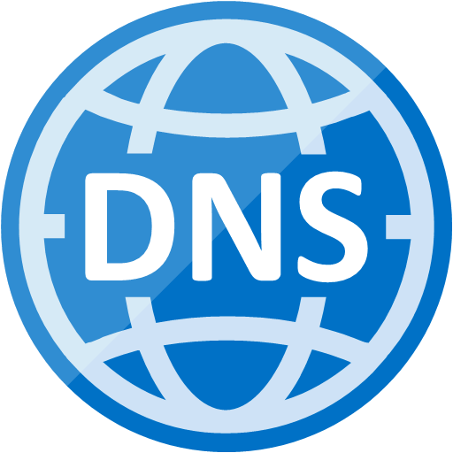




Robust networking infrastructure services
Virtual Network
Provision private networks, optionally connect to on premise datacenters. NSG, User Defined Routes, & IP addresses.
Load Balancer
Deliver high availability and network performance to your applications
Application Gateway/WAF
Build scalable and highly-available web front ends in Azure
DDoS Protection
Protect your Azure resources from DDoS attacks
VPN Gateway
Establish secure, cross-premise connectivity
Azure DNS
Host your DNS domain in Azure
Content Delivery Network
Ensure secure, reliable content delivery with broad global reach
Traffic Manager
Route incoming traffic for high performance and availability
ExpressRoute
Dedicated private network fiber connections to Azure
Network Watcher
Network performance monitoring and diagnostics solution
Notes:
These are all the component pieces of Azure’s networking infrastructure

Slide 5
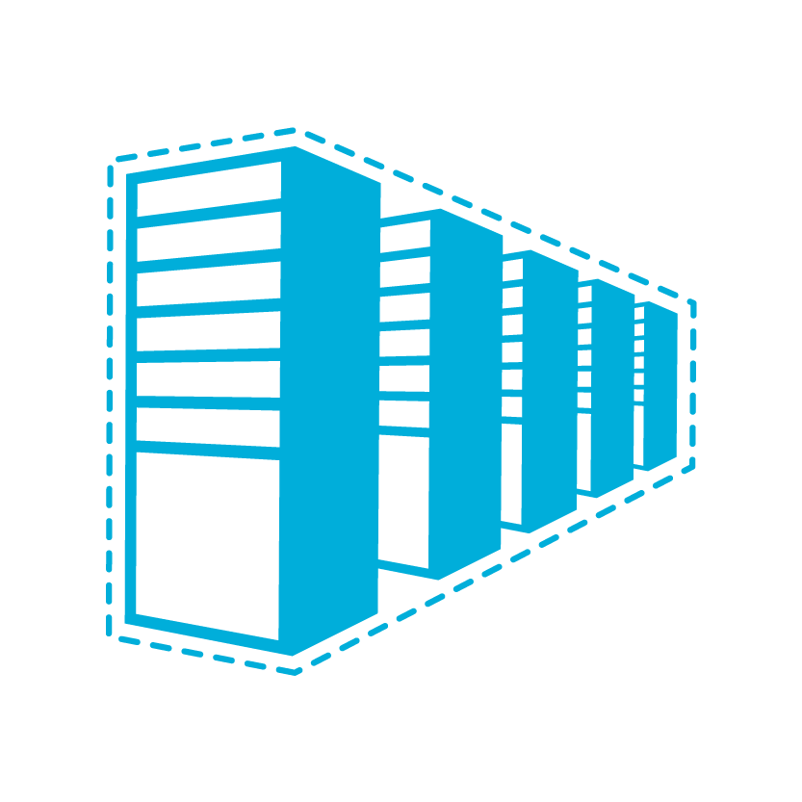


Connectivity to Azure
Cloud
Customer
Characteristics
Internet facing with public IP addresses in Azure
DNS, load balancing, DDoS protection, WAF
Internet Connectivity
Remote Access to VNet/On-prem
Connect from anywhere
Mac, Linux, Windows
Radius/AD authentication
Remote access point-to-site connectivity
High throughput, secure cross-premises connectivity
BGP, active-active for high availability & transit routing
Site-to-site
VPN connectivity
Private connectivity to Microsoft services (O365, Azure PaaS services)
Mission critical workloads
ExpressRoute private connectivity

Slide 6
Connectivity within Azure
Cloud
Cloud
Characteristics
Same-/cross-region direct, private VM-to-VM connectivity
NSG & UDR across VNets
GatewayTransit for hub-and-spoke
VNet Peering
Transitive routing via BGP and VPN gateways
Secure connectivity via IPsec/IKE across Azure WAN links
VNet-to-VNet via Gateways

Slide 7


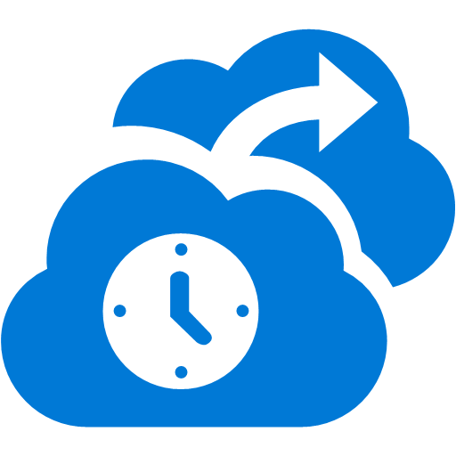










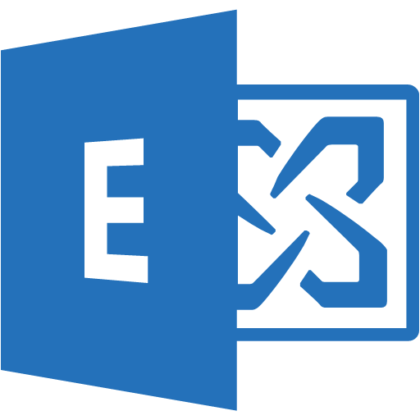
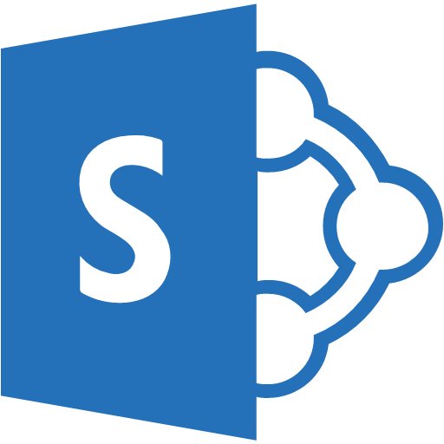
Cross-premises connectivity
Microsoft
P2S tunnels
Virtual Network
Internet
Backend
Mid-tier
Frontend
S2S tunnels
Private WAN
ExpressRoute

Slide 8
S2S VPN

Slide 9
VPN Gateways
SKU | Workload | Throughput* | S2S/V2V | SLA
VpnGw1 | Production | 650 Mbps | Max. 30 | 99.95%
VpnGw2 | Production | 1 Gbps | Max. 30 | 99.95%
VpnGw3 | Production | 1.25 Gbps | Max. 30 | 99.95%
Basic | Dev/Test | 100 Mbps | Max. 10 | 99.9%
Type
Route-based – router (IKEv2)
Policy-based – firewall (IKEv1)
SKUs
Mainly differentiate on throughputs
Same feature sets (except Basic)
Features
BGP, transit routing, forced tunneling
Gateway transit (VNet peering)
Active-active
Custom policy – IPsec/IKE

Slide 10
Secure VPN transit
BGP for redundant paths and dynamic routing Automatic shortest path selection and failover
Transit over Microsoft global network Secure connectivity using Internet only for “last mile”
ASN
VNet 3
Full mesh
65030
Redundant paths
Central US
BGP
BGP
ASN
65040
ASN
65050
BGP
BGP
BGP
VNet 2
VNet 1
S2S VPN
West US
East US
S2S VPN
On-Premises
ASN
65020
ASN
65010
On-Premises
Site 4
Site 5

Slide 11
Dual Redundancy with Active-Active gateways
Zero downtime during planned maintenance
From active-standby to active-active
Support both cross-premises and VNet-to-VNet connectivity
Spreading traffic over multiple tunnels simultaneously
VNet1
East US
ASN 65010
10.11.0.0/16
10.11.0.0/16
Azure VPN
On Premises VPN 1
On Premises
Site 5
ASN65050
10.51.0.0/16
10.52.0.0/16
Azure VPN 2
On Premises VPN 2

Slide 12
Configurable IPsec/IKE policy
Compliance & security requirements
Per connection IPsec/IKE policy
Encryption, integrity, DH/PFS groups, SA lifetime
On Premises Site 2
10.2.0.0/16
Connection 1 policy:
IKE: AES256, SHA386, DH14
IPsec: GCMAES256, GCMAES256, PFS24
On Premises Site-2
VNet1
10.1.0.0/16
Azure VPN
Connection 2 policy:
IKE: AES128, SHA1, DH2
IPsec: AES256, SHA256, PFS24
On Premises Site 3
10.3.0.0/16
On Premises Site-3

Slide 13

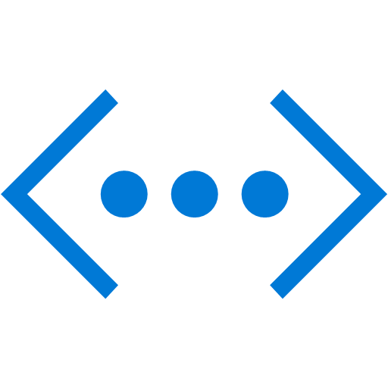
VPN download device scripts
S2S VPN
Apply custom IPsec/IKE policy for compliance (encryption/integrity, PFS, DH)
Download VPN device scripts for seamless configurations
VNet
On-Premises Network
Azure
Custom Policy
S2S VPN Tunnel
Headquarters
VPN device configuration scripts

Slide 14
P2S VPN for Remote Access

Slide 15

P2S for macOS/Linux & AD authentication
P2S VPN
P2S VPN for mobile users & developers to connect from anywhere
Now supporting macOS and Windows
AD/Radius authentication for enterprise grade identity solution
VNet
On-Premises Network
Azure
AD/DS
AD/DS
S2S VPN Tunnel
Headquarters
S2S VPN
AD
Auth
P2S VPN
macOS, Linux/Android,
Windows 10/Server 2016
From Internet

Slide 16
Large scale, multi-platform P2S VPN
Roadmap – 8x P2S VPN connections
Active-active allows bursting up to 2x P2S connections (2000, 1000, 500)
SKU | P2S – IKEv2* | P2S – SSTP | S2S/V2V | Throughput
VpnGw3 | 1,000 | 128 | Max. 30 | 1.25Gbps
VpnGw2 | 500 | 128 | Max. 30 | 1.00Gbps
VpnGw1 | 250 | 128 | Max. 30 | 650Mbps
Basic | N/A | 128 | Max. 10 | 100Mbps
P2S with IKEv2
Windows 10 & Windows Server 2016*
Linux & Android via StrongSwan
Mac (macOS 10.12 and higher)
Radius/AD authentication
Username/password
Certificate-based (EAP-TLS)
MFA via NPS extension + Azure MFA**
Notes:
(*) Additional KB* & regkey settings for Windows 10 & Windows Server 2016
Windows 10 (version 1607) & Windows Server 2016: KB4057142
Windows 10 (version 1703): KB4057144
Create or set regkey “HKEY_LOCAL_MACHINE\SYSTEM\CurrentControlSet\Services\RasMan\ IKEv2\DisableCertReqPayload” to 1 (REG_DWORD)
(**) Refer to https://docs.microsoft.com/en-us/azure/multi-factor-authentication/multi-factor-authentication-nps-extension

Slide 17
ExpressRoute

Slide 18




ExpressRoute
✔ Unified connectivity to Microsoft Cloud Services
✔ Predictable performance
✔ Enterprise-grade resiliency and with SLA for availability
✔ Large and growing ExpressRoute partner ecosystem
✔
✔
Customer’s Network
Partner Edge
Primary Connection
Microsoft Edge
Secondary Connection
ExpressRoute Circuit
Microsoft Peering for Office 365 and Dynamics 365
Microsoft Peering for Office 365, Dynamics 365, Azure Public IPs
Azure Public Peering for Azure public IPs
Azure Private Peering for Virtual Networks

Slide 19
Terminology & concepts
Circuit
The unit of ExpressRoute “connectivity”
Bandwidth (50M-10G), provider, location (e.g., 1Gbps, Verizon, Chicago)
Peering
Connectivity types – to customer “private” networks (VNets) or to “Microsoft” services – Azure PaaS, O365, Dynamics
Route filter & BGP community
Specify (route filters) or identify (BGP community) what services to connect from on-premises to Microsoft Services
Gateway & connection
Connecting an ExpressRoute circuit to Azure Virtual Networks

Slide 20
ExpressRoute locations
Montreal
Dublin
Amsterdam 2
Seattle
Toronto
Newport, Wales
Amsterdam
Silicon Valley 2
Chicago
Quebec City
London
Paris
Seoul
Busan
Silicon Valley
Denver
London 2
New York City
Marseille
Las Vegas
Dallas
Washington DC
Tokyo
Washington DC 2
Osaka
Los Angeles
Atlanta
San Antonio
Miami
Hong Kong
Mumbai
Chennai
Kuala Lumpur
Singapore 2
Singapore
Johannesburg
Sao Paulo
Cape Town
Canberra
Sydney
Roadmap
Melbourne

Slide 21














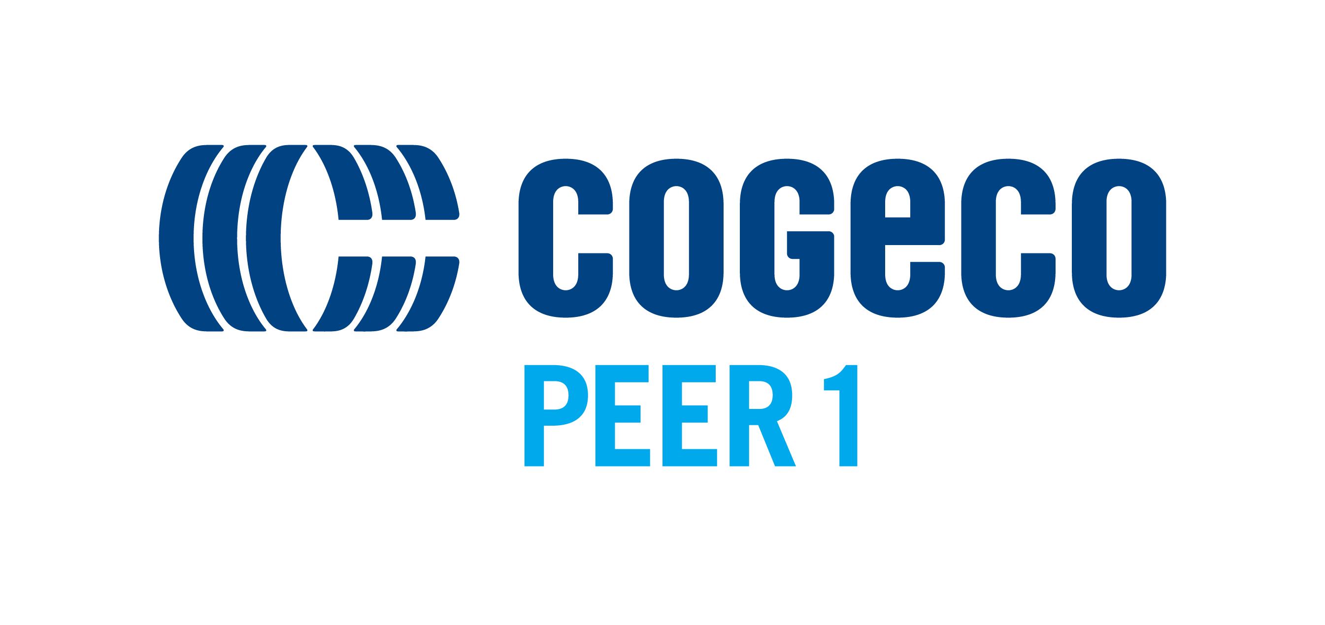











































































ExpressRoute Providers/Partners

Slide 22
Routing in Azure

Slide 23
Azure routing 101
Routing & forwarding
Based on destination (IP), decide where (nexthop) to send a packet
Longest prefix match – the most specific route wins
10.0.0.0/16 vs. 10.0.0.0/24
Intra VNet – send directly among VNet VMs
Cross-premises – nexthop Azure VPN gateway
Same routing lookup in VPN gateway to decide which IPsec tunnel to send the packet
On Premises Site 2
10.2.0.0/16
On Premises Site-2
VNet1
10.1.0.0/16
Azure VPN
On Premises Site 3
10.3.0.0/16
On Premises Site-3

Slide 24
Azure routing 102
BGP (Border Gateway Protocol) & gateway routes
Dynamic routing – allows gateways to exchange routes dynamically, and propagate to all other connected gateways
Can be overridden by static (manual) routes
VPN & ExpressRoute gateway will “inject” routes to the entire virtual network
Can be disabled by Routing Table option “Disable BGP route propagation” on individual subnets
BGP
Azure VPN
10.1/16
10.3/16
On Premises Site 2
10.2.0.0/16
On Premises Site-2
VNet1
10.1.0.0/16
BGP
Azure VPN
On Premises Site 3
10.3.0.0/16
Azure VPN
10.1/16
10.2/16
On Premises Site-3

Slide 25
Azure routing 103
UDR – User-Defined Routes
Manual/static routes added to a subnet
Overrides BGP/dynamic routes and system default in tie breaker
Longest prefix match still wins (e.g., 10.100.0.0/24)
Routes for the same destination AND prefix
( ) Dynamic 10.100.0.0/16 ➔ Azure VPN gateway
(√) UDR 10.100.0.0/16 ➔ Virtual appliance
BGP
Azure VPN
10.1/16
10.3/16
On Premises Site 2
10.2.0.0/16
On Premises Site-2
VNet1
10.1.0.0/16
BGP
Azure VPN
On Premises Site 3
10.3.0.0/16
Azure VPN
10.1/16
10.2/16
On Premises Site-3

Slide 26
Azure routing 104
System routes – “Effective routes”
System default – (1) Intra-VNet ➔ direct; (2) Default route ➔ Internet
VNet injected routes into UDR
VNet peering ➔ Adding peered VNet prefixes (e.g.,10.20.0.0/16) ➔ VNet peering
Service endpoints ➔ Adding public IP address(es) for a service (e.g., Azure storage) ➔ Service Endpoint
On Premises Site 2
10.2.0.0/16
On Premises Site-2
VNet2
10.2.0.0/16
VNet peering
VNet1
10.1.0.0/16
Service
Endpoint
Azure VPN
On Premises Site 3
10.3.0.0/16
Azure Storage
On Premises Site-3

Slide 27



Azure routing 400
Can a hub talk to another hub?
VNet Peering, ExpressRoute, or VPN?
Can a spoke talk to another spoke in the same hub?
Can a spoke talk to another spoke in a different hub?
Global VNet Peering, ExpressRoute, or VPN?
Would Service Endpoint access get forced tunneled?
Would BGP advertised peered VNets prefixes to on-premises?
Would it take ExpressRoute or VPN to the on-premises networks?
Multiple ExpressRoute circuits?
Co-existence?
VPN Active-active?
Can P2S connect to on-premises?
Azure Region 1
Azure Region 2
Azure
Azure
Azure
Hub
Hub
VNet Peering
S2S VPN Tunnel
S2S VPN Tunnel
P2S VPN
S2S VPN
ExpressRoute
From Internet
Customer Networks
Notes:
We high light the new announcements
Vnet peering. We mention that the VPN tunnel between regions is replaced by the VNet peering. Bottlenecks are removed.
We highlight the fact that we can now talk to non-Windows clients – namely Apple IOS clients.
We highlight ExpressRoute and have a pop up box where we list the set of features (feature list will have 3 – 4 bullets).

Slide 28
How do I know which route(s) to take?
LPM (Longest Prefix Match) rules!
Routes with the longest prefix match of the destination will be taken
LPM == “more specific route”
10.0.0.0/24 is more specific then 10.0.0.0/16
Tie breaker – Static >> BGP >> System
Static routes
User-defined routes
Service endpoints*
VNet peering*
(*) Added by the system in UDR, but you can add routes to override
BGP / Gateway routes
BGP routes advertised via ExpressRoute or VPN ➔ Inject into the whole VNet
VPN gateway static routes
System routes
Intra-VNet direct & default to Internet
Hub-and-Spoke routing
Prefer VNet peering over ExpressRoute or VPN VNet-to-VNet
Prefer VNet Service Endpoints (Storage & SQL) over BGP routes (forced tunneling)
Prefer ExpressRoute over VPN in co-existence scenarios
Prefer ExpressRoute connections with higher connection weight
Prefer “shortest” path – honor AS prepending
Spoke-to-spoke in one hub is NOT connected by default – VNet peering is non-transitive
Spoke-to-spoke between two hubs works through gateway transit

Slide 29
How do I control which route(s) to take?
ECMP – Equal-Cost, Multi-Path
“When in doubt, spread …”
Multiple paths (nexthops) to the same destination
Two UDR routes to different virtual appliances
Active-active VPN gateway
Multipath topology via BGP routing
Spreading is on “flows”
Packets of one flow always follow the same path (gateways, tunnels)
Flow - 5-tuple (TCP/UDP)
Prefer one path over the others
MUST be done on BOTH ends
Prevent asymmetric routing
Azure ➔ on-premises network
AS-prepending – create longer AS paths for certain routes
Azure gateways will favor or prefer routes with shorter AS paths
ExpressRoute connection weight – prefer connections with higher weights
Apply higher connection weights to the closer ExpressRoute circuits
On-premises network ➔ Azure
Local preference

Slide 30
Common routing patterns problems
Forced tunneling
Everything goes back to on-premises for inspection/auditing
Compliance requirement for most enterprises
Breaks Internet-facing VMs
Internet ➔ VM public IP: 128→151
VM ➔ on-premises proxy / NAT ➔ Internet: 181→128
Breaks first party “VNet injection” services
Azure App Service Environment (ASE)
VPN/ExpressRoute gateways
On-premises networks to Azure PaaS
ExpressRoute Microsoft peering only
On-premises networks to Service Endpoints
No (*)
(Sub-) Optimal routing
Azure
US West
Azure
US East
WAN
Los Angeles
New York
Asymmetric routing
Two paths to MS (O365)
Internet & ExpressRoute
O365 reaches corp via Internet
Response goes through ExpressRoute

Slide 31

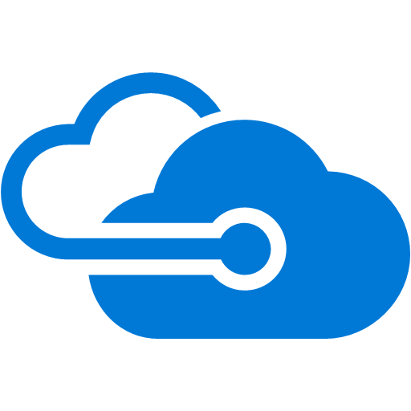

Connection weight and BGP attributes
US West
Microsoft Network
US East
W=100
W=100
Use connection weight to select the path from Microsoft to you
ExpressRoute
ExpressRoute
If both connection weight and AS-path prepending are applied, path is selected based on the former
Use “local preference” to select the path for traffic from you to Microsoft
Customer’s Network
Los Angeles
New York

Slide 32
Scale & Availability
Notes:
How to create Scale & Availability in Azure

Slide 33



Azure’s load balancing portfolio
DNS
Global
Traffic Manager
Public
CNAMEs
HTTP / HTTPS
Regional
Public &
Internal
Application Gateway
Requests
All TCP & UDP
Regional
Public &
Internal, + AZ’s
Load Balancer
Flows
Notes:
Load balancing portfolio
Three fully managed products

Slide 34
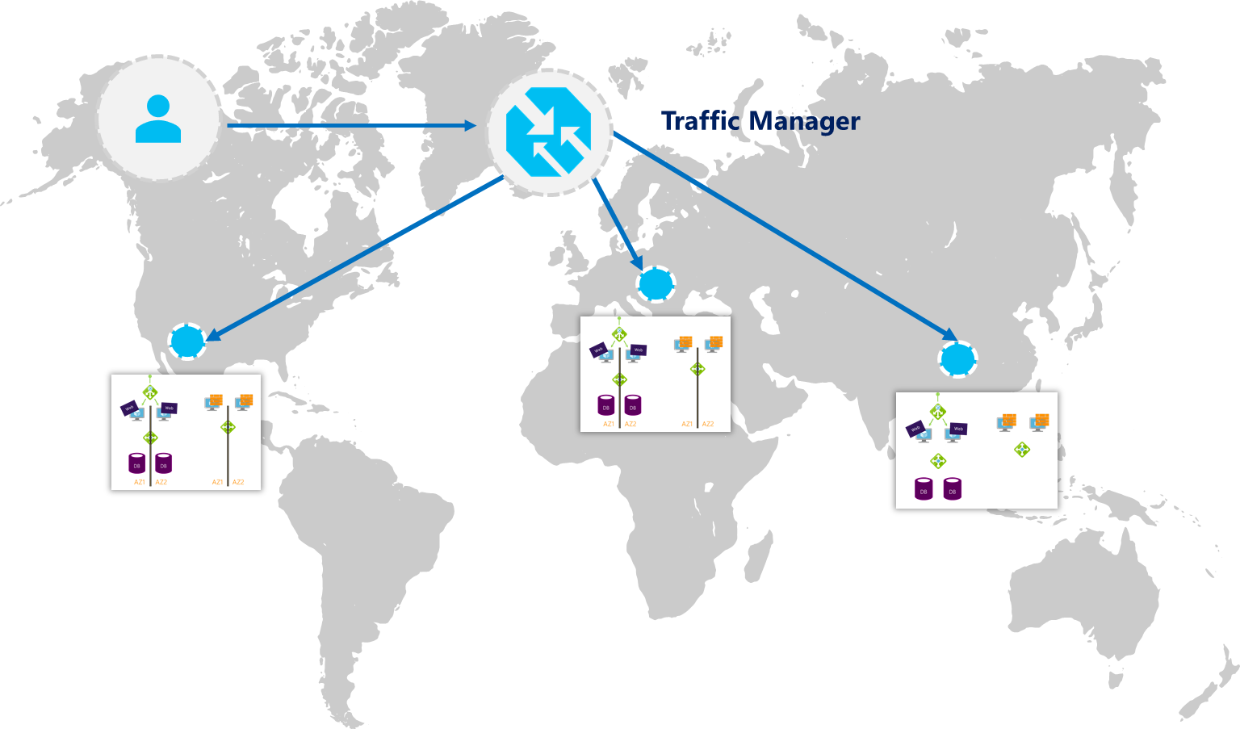
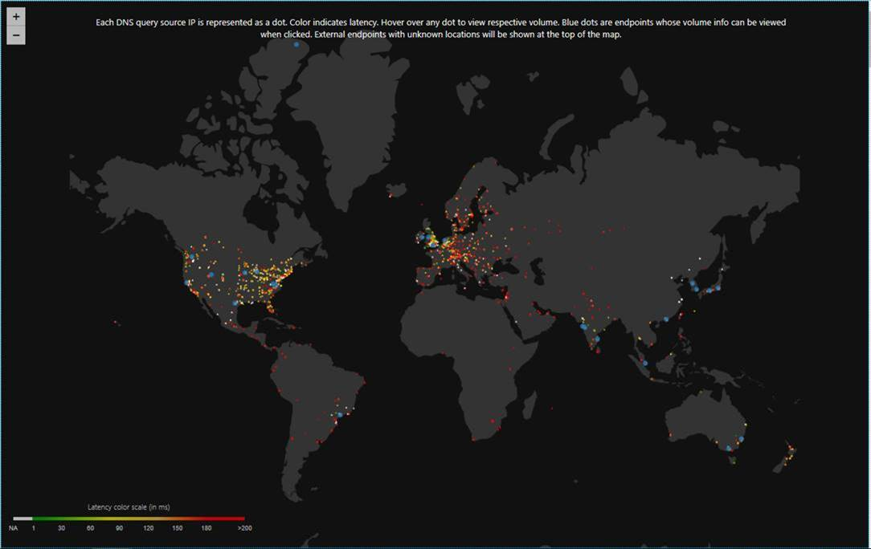
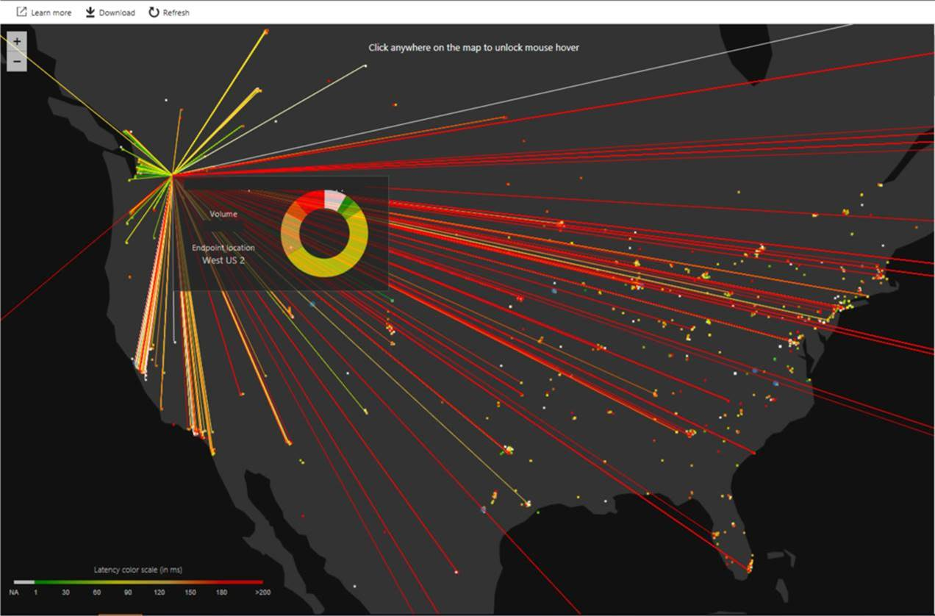
Traffic Manager
DNS request routing
Easy Onboarding
Multiple Routing Methods
Endpoint monitoring
High resiliency
Real User Measurement & Traffic View
Routing based on profiles
Priority
Weighted Round Robin
Geographic
Performance
Diagnostics and Probes
Traffic View visualization
Understand the volume of traffic generated by your users and the latency experienced by them, at a per region level
TCP & HTTP health probes
Nesting of profiles

Slide 35
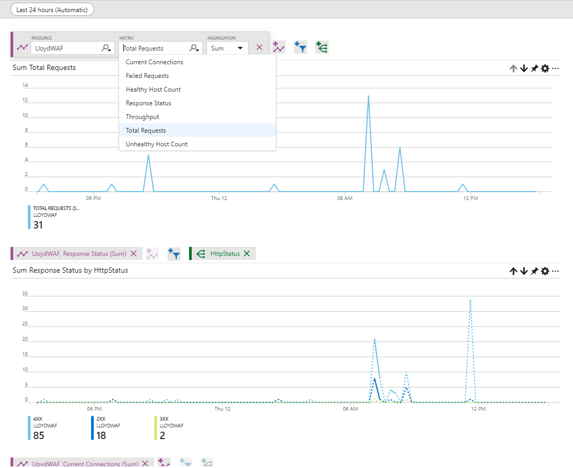
Application Gateway
Layer 7, per request routing
HTTP round robin
Cookie based session affinity
Multi-site hosting
URL based routing
Application layer security
SSL termination
SSL Policy (protocol version and cipher)
End to end SSL
Web Application Firewall
Diagnostics and probes
Access, performance, backend health logs
Monitor metrics & alerts: Total request, Failed requests, Healthy/Unhealthy host counts, Response status distribution (2xx, 3xx, 4xx, 5xx), Throughput
Custom health probes (HTTP, HTTPS)
fabrikam.com
Support Web Apps
Redirection
Application Gateway
Videos
contoso.com
fabrikam.com
Images
contoso.com/video/*
contoso.com/images/*
Notes:
AppGw is platform managed, dedicated deployment. Azure takes care of availability, patching, management of these deployments for you.
Application Gateway like ALB is regional in scope but has more advanced connectivity options. You are not limited to scale sets or VNets.
AppGw can be deployed as both public facing or internal ILB only. More importantly you can use AppGw with both end points exposed at the same time to function as both internal and external layer 7 ADC.
AppGw is a SSL terminating reverse proxy which offers many functionalities.
It is difficult to list down all the capabilities in one chart but here is an attempt. We offer layer 7 routing capabilities like
true round robin load distribution on per http request basis
Ability to pin a user session to the same VM even when originating traffic is behind CDN or proxy
Ability to host multiple sites behinds the same Application Gateway
And many more

Slide 36
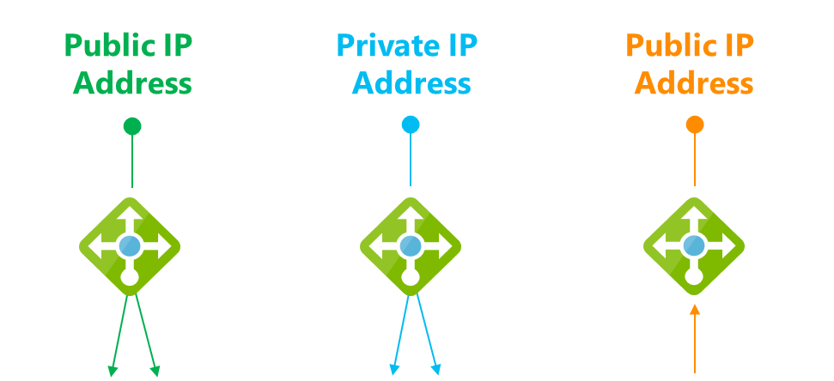

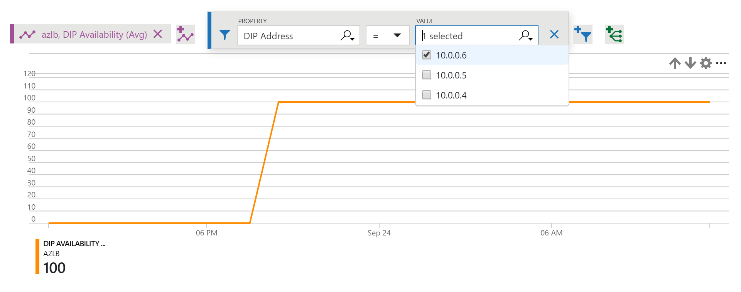
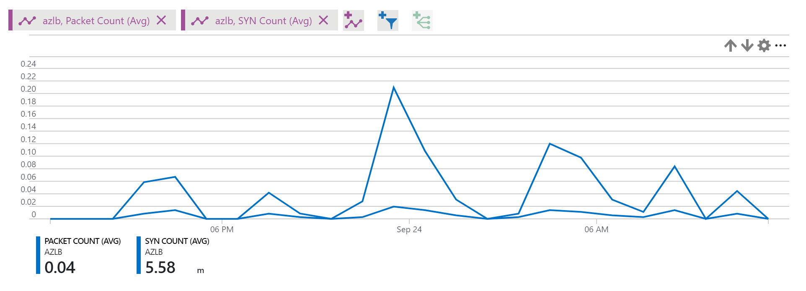
Load Balancer
Layer 4, per flow
All TCP & UDP applications
Inbound & outbound
Flow-based Load Balancing with Health Probing
Inbound NAT rules (port forwarding)
Availability Zones support
HA Ports load balancing
2 SKUs: Standard & Basic
High performance
Part of the Azure SDN stack, not a VM
Low latency
High throughput
Outbound bandwidth only limited by VM in pool
Diagnostics and Probes
Multi-dimensional metrics and alerts in Azure Monitor
TCP & HTTP health probes, Data path health
F
3 key scenarios

Slide 37



Combine them as needed
DNS
Traffic
Manager
Load Balancer
Application Gateway / WAF
Load Balancer
DB
DB
DB
DB
DB
DB
DB
DB
REGION A
REGION B
Scalable
Redundant
+ AZ’s
Scalable
Redundant
+ Per Request
+ Security
Scalable
Redundant
Per Request
Security
+ Cross-region
Notes:
Let’s dive a little deeper.
You can use Azure Load Balancer for your scenarios and create scalablility and redundancy <CLICK>
You could also choose to use Application Gateway and WAF to add additional layer 7 processing and protection <CLICK>
And lastly, you can scale out across multiple regions using DNS load balancing with Traffic Manager
We have solutions for all your load balancing needs, whether that is
layer 4 TCP and UDP,
layer 7 HTTP, HTTPS,
or global DNS load balancing

Slide 38


Standard LB for entire VNet
Load Balancer Standard
VNet
Any VM in a VNet in a backend pool
(no Availability Set boundary)
Standalone VMs without Availability Sets
Standalone VMs with Availability Sets
Virtual machine scale sets with up to 1000 instances
Zonal and Cross-zone VMSS
Multiple standalone VM, Availability Sets, VMSS
Blending VMs and virtual machine scale sets
VM scale set
VM scale set
VM scale set
Zone 1
Zone 2
Zone 3
Load Balancer Standard
VNet
Secure by default
Use NSG to explicit whitelist traffic you want to permit
VM Scale Set
Zone 1
Zone 2
Zone 3

Slide 39
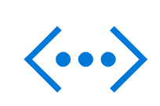
Standard LB & AZs: Zone-redundant by default
Zone-redundant data path
(regional anycast, public & internal, inbound & out)
AZ’s & Inbound and outbound flows
Zone-redundant default (single IP)*
Optional: Zonal guarantee option
Cross-zone load balancing
Load Balancer
Standard
Zonal VM
Zonal VM
Zonal VM
Zone 1
Zone 2
Zone 3
* Only in Azure, more at aka.ms/lbaz
Notes:
Really excited to announce load balancer standard
Next generation of the load balancer platform
Expands to the entire vnet, with or without availability sets
Up to 1000 instances in the backend pool
Which includes also 1000 instance VMSS
HA ports for internal load balancing and scaling of network virtual appliances
And any application which needs a large number of ports
Advanced analytics to simplify operations
Support for availability zones

Slide 40
Which SKU?
aka.ms/lbstandard
vs.
Standard
Up to 1000 backend instances
All scenarios, including AZ (Zone-redundant & Zonal frontend & outbound)
Any VM or VMSS in VNet
public and internal Load Balancer via Azure Monitor (multi-dimensional metrics): Active data plane health measurement (“VIP Availability”) (public only for now) Traffic counters, health probes, connection attempts (TCP SYNs), outbound connection health
Multiple frontends for outbound with per rule opt-out
Supports HA Ports load balancing rules
Secure by default (default closed)
Default SNAT (pseudo VIP) not available
Charged based on # of load balancing rules & data processed
vs.
Basic
Up to 100 backend instances
Non-AZ scenarios only
Single Availability Set only
public Load Balancer only via Log Analytics: SNAT exhaustion alert Backend pool health count
Single frontend for outbound, selected at random
/
Open by default
Default SNAT allowed
Free
Why Standard?
Larger scale
Greater flexibility
Availability Zones
New metrics / diagnostics
Internal HA Ports
Secure by default
Faster operations
99.99% SLA
Notes:
Let’s dive a little deeper.
You can use Azure Load Balancer for your scenarios and create scalablility and redundancy <CLICK>
You could also choose to use Application Gateway and WAF to add additional layer 7 processing and protection <CLICK>
And lastly, you can scale out across multiple regions using DNS load balancing with Traffic Manager
We have solutions for all your load balancing needs, whether that is
layer 4 TCP and UDP,
layer 7 HTTP, HTTPS,
or global DNS load balancing

Slide 41
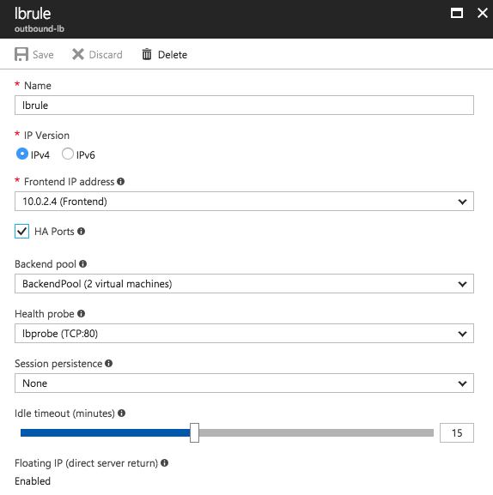
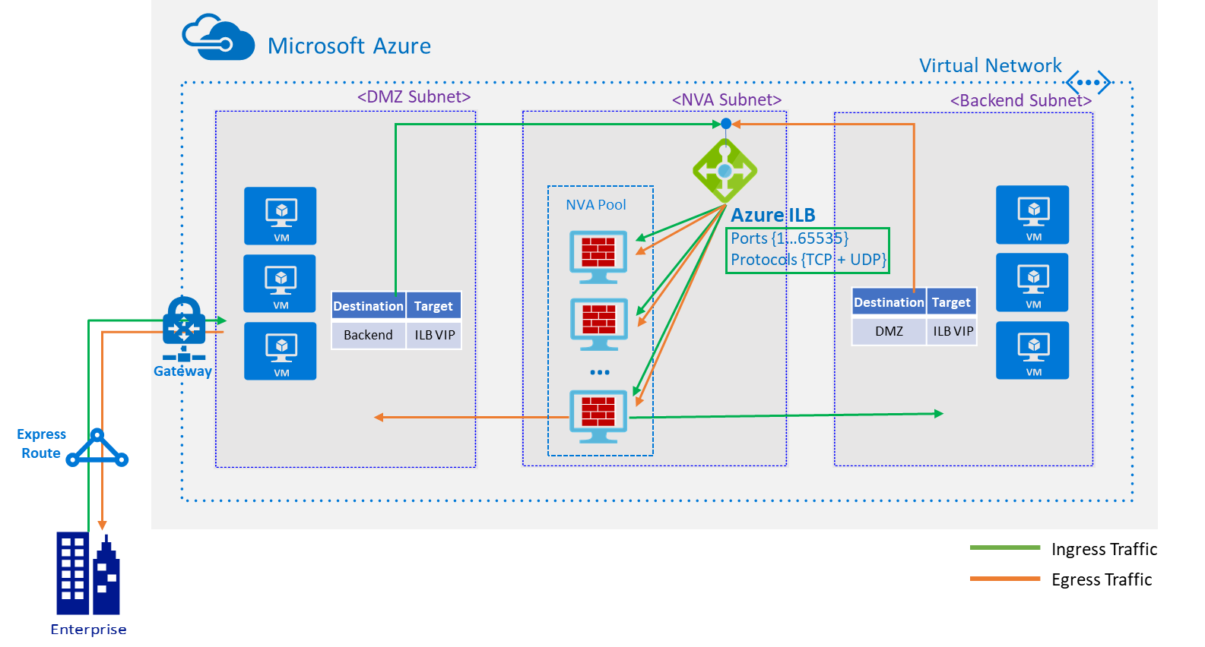
Use internal HA Ports rules to scale NVA in VNet
Standard LB
Ports 1-65535
TCP & UDP
Active-active
Or active-passive
Scale out
Ask your NVA vendor for recommended configuration & support!
Notes:
Let’s dive a little deeper.
You can use Azure Load Balancer for your scenarios and create scalablility and redundancy <CLICK>
You could also choose to use Application Gateway and WAF to add additional layer 7 processing and protection <CLICK>
And lastly, you can scale out across multiple regions using DNS load balancing with Traffic Manager
We have solutions for all your load balancing needs, whether that is
layer 4 TCP and UDP,
layer 7 HTTP, HTTPS,
or global DNS load balancing

Slide 42

Build outbound stacks with HA Ports rules
internal
Standard LB
User-Defined Route
Public IPs
Internet
with HA Ports
load-balancing rule
VM deployment
pool
traffic flow, all ports on internal IP load balanced across pool
Notes:
Let’s dive a little deeper.
You can use Azure Load Balancer for your scenarios and create scalablility and redundancy <CLICK>
You could also choose to use Application Gateway and WAF to add additional layer 7 processing and protection <CLICK>
And lastly, you can scale out across multiple regions using DNS load balancing with Traffic Manager
We have solutions for all your load balancing needs, whether that is
layer 4 TCP and UDP,
layer 7 HTTP, HTTPS,
or global DNS load balancing

Slide 43


Diagnostics: Two major options, and more
Monitor
all of Azure
metrics & alerts
multi-dimensional
group, filter as needed
export to others
Network Watcher
scenario based
visualize and troubleshoot
investigate deeper
w/ packet captures etc
+ Product specific diagnostics and visualizations!
Notes:
Really excited to announce load balancer standard
Next generation of the load balancer platform
Expands to the entire vnet, with or without availability sets
Up to 1000 instances in the backend pool
Which includes also 1000 instance VMSS
HA ports for internal load balancing and scaling of network virtual appliances
And any application which needs a large number of ports
Advanced analytics to simplify operations
Support for availability zones

Slide 44
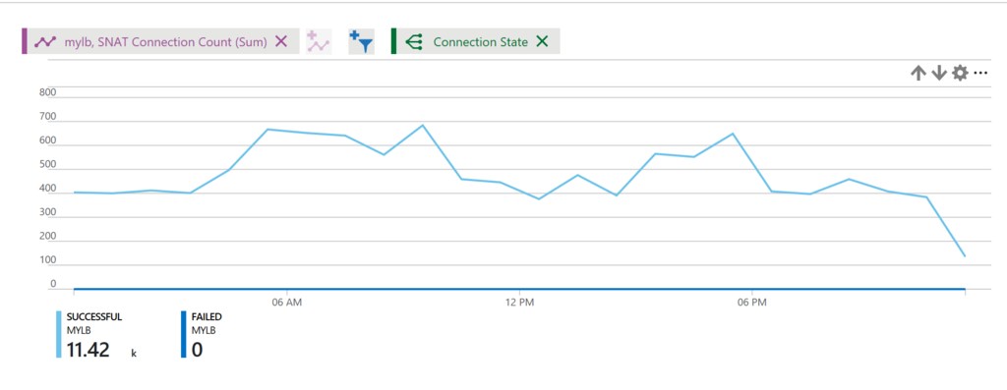
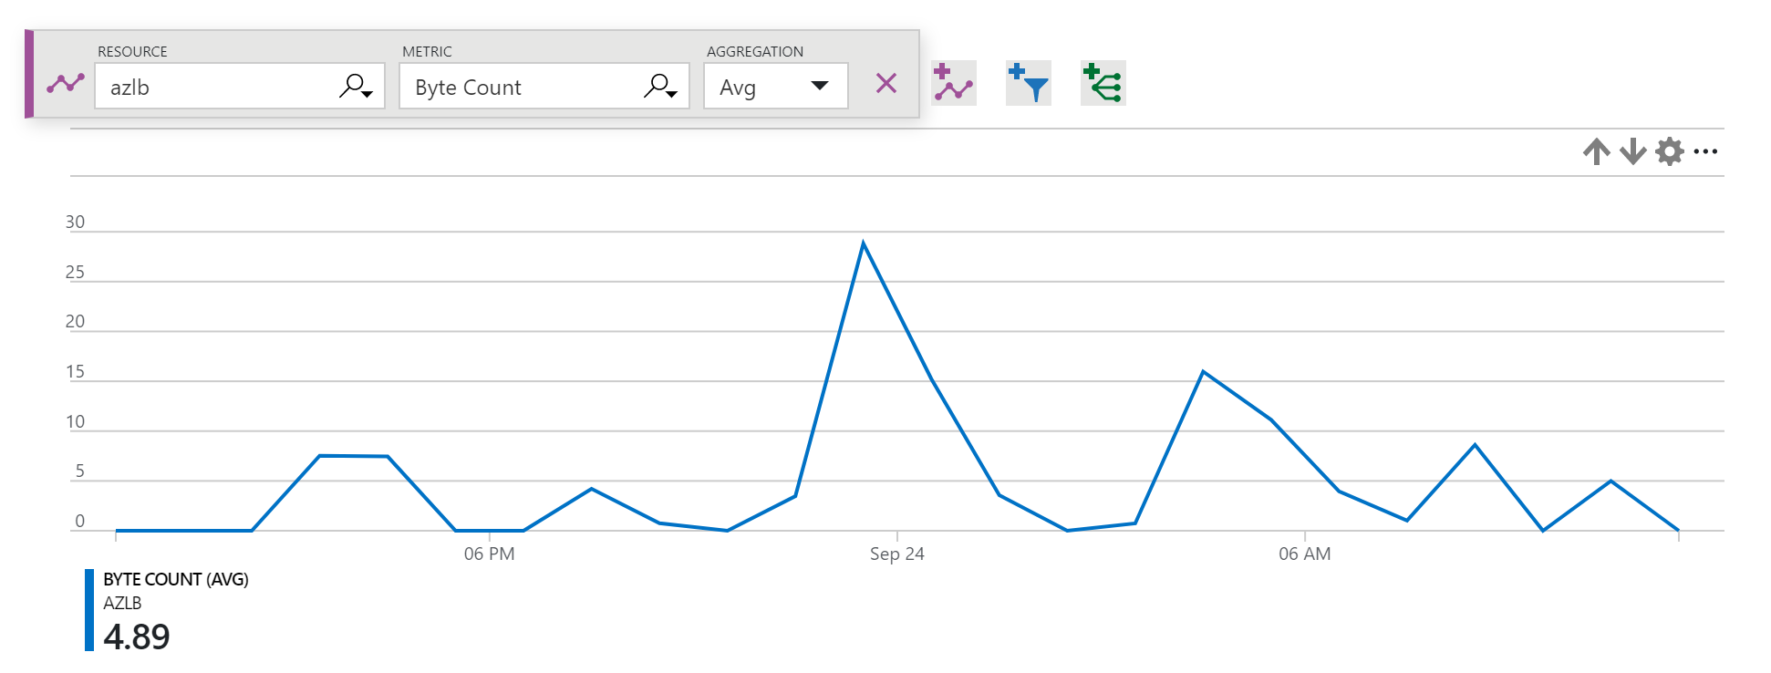
Example: Standard LB metrics
Azure Monitor
Group & filter Metrics & Alerts
Health probe status
Outbound connection health (SNAT success/failure)
Packet counters, connection attempts (TCP SYN)
Byte counters
Notes:
Let’s dive a little deeper.
You can use Azure Load Balancer for your scenarios and create scalablility and redundancy <CLICK>
You could also choose to use Application Gateway and WAF to add additional layer 7 processing and protection <CLICK>
And lastly, you can scale out across multiple regions using DNS load balancing with Traffic Manager
We have solutions for all your load balancing needs, whether that is
layer 4 TCP and UDP,
layer 7 HTTP, HTTPS,
or global DNS load balancing

Slide 45
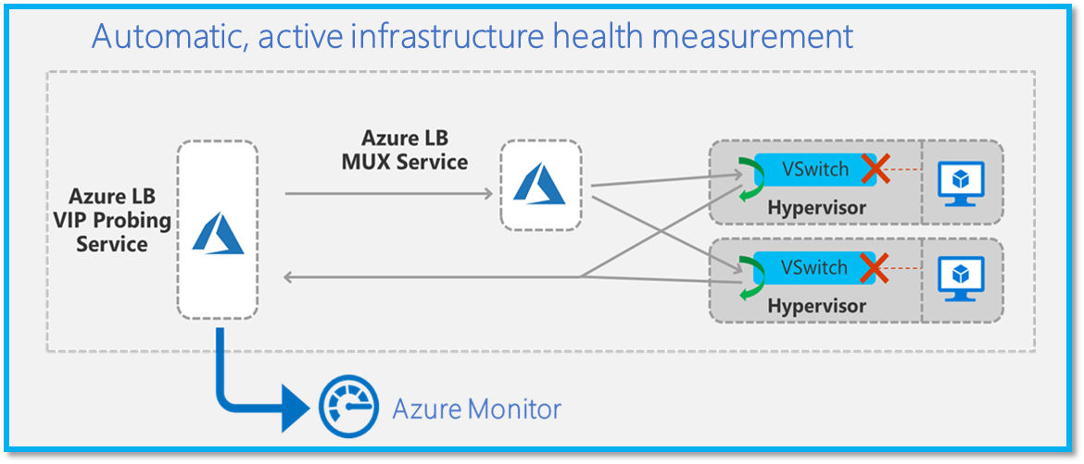
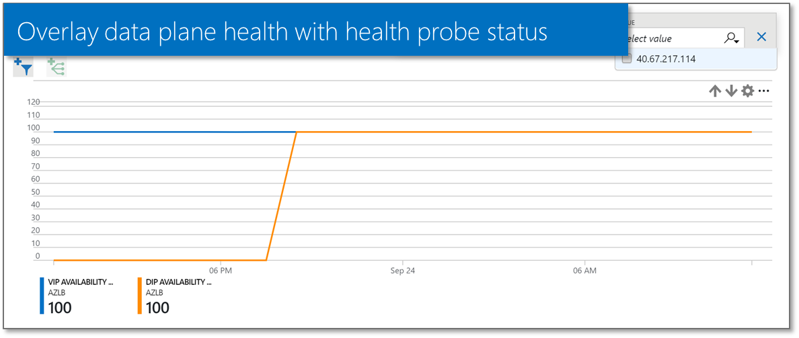
Standard LB & VIP Availability
Azure Monitor
Group & filter Metrics & Alerts
Assurance:
“Can my app frontend be reached?”
Fault isolation:
“Is it Azure or is it me?
Understand the stack
Invisible to application
Starts when you deploy
Only in Azure
Servers up!
Notes:
Let’s dive a little deeper.
You can use Azure Load Balancer for your scenarios and create scalablility and redundancy <CLICK>
You could also choose to use Application Gateway and WAF to add additional layer 7 processing and protection <CLICK>
And lastly, you can scale out across multiple regions using DNS load balancing with Traffic Manager
We have solutions for all your load balancing needs, whether that is
layer 4 TCP and UDP,
layer 7 HTTP, HTTPS,
or global DNS load balancing

Slide 46
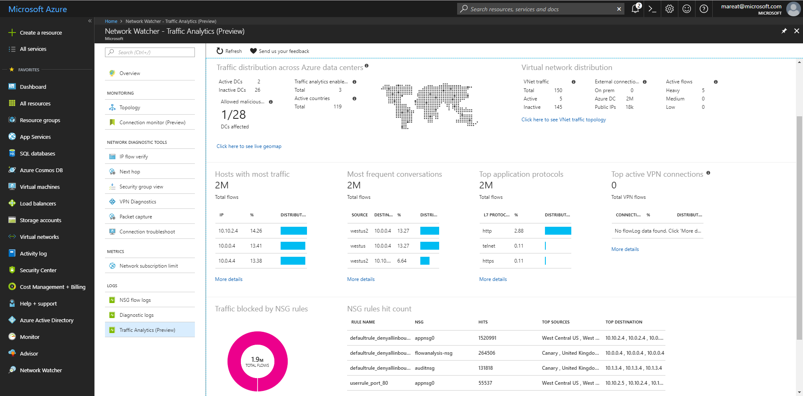
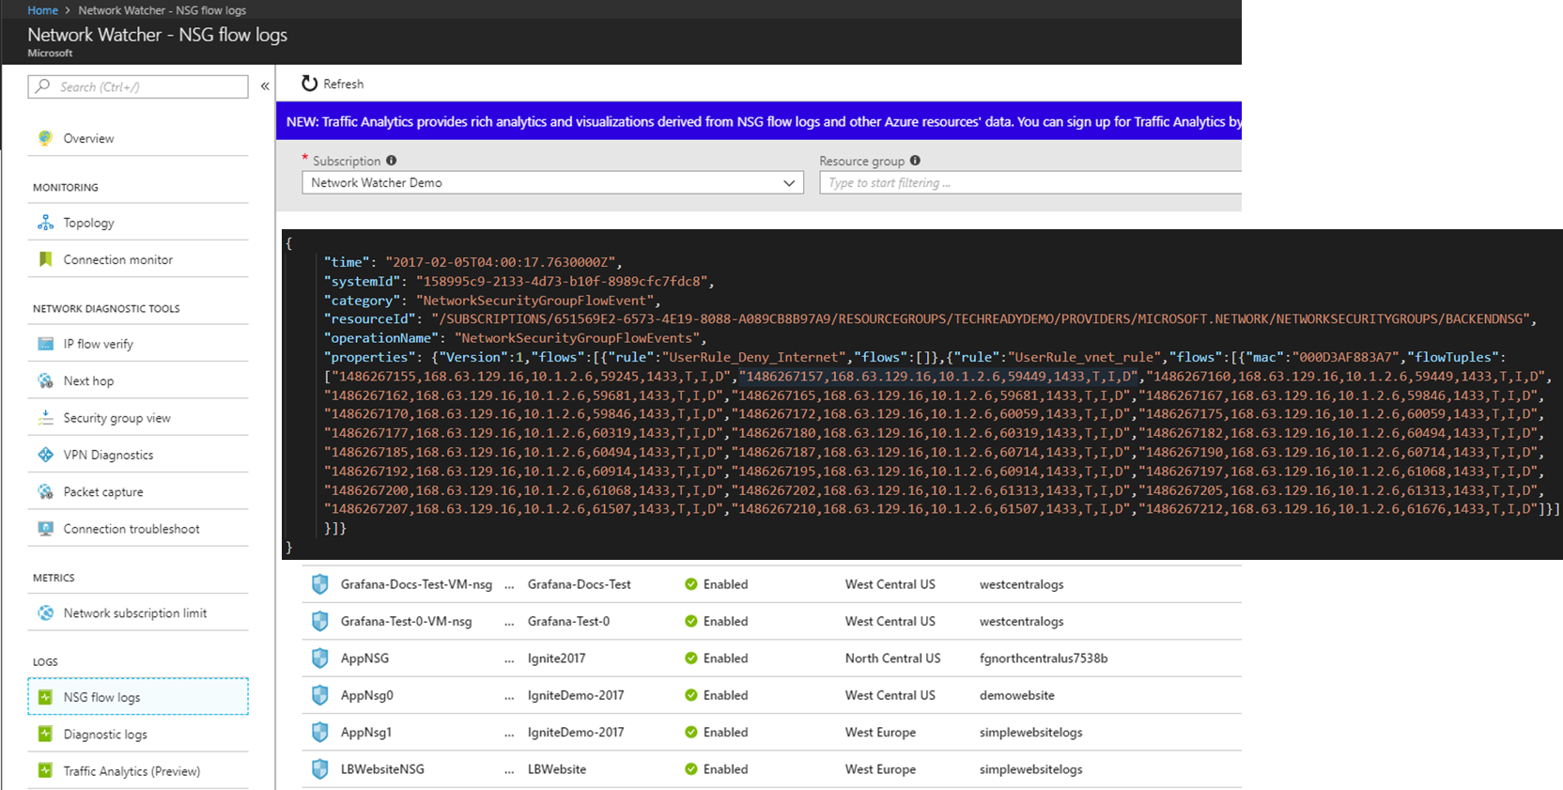
Network Watcher: Visualize and Troubleshoot
Notes:
Let’s dive a little deeper.
You can use Azure Load Balancer for your scenarios and create scalablility and redundancy <CLICK>
You could also choose to use Application Gateway and WAF to add additional layer 7 processing and protection <CLICK>
And lastly, you can scale out across multiple regions using DNS load balancing with Traffic Manager
We have solutions for all your load balancing needs, whether that is
layer 4 TCP and UDP,
layer 7 HTTP, HTTPS,
or global DNS load balancing

Slide 47
Traffic View: TM-specific Visualization
Understand the volume and experience of your users at a per region level
Deep dive into traffic flow patterns in a specific region

Slide 48
Security
Notes:
How to create Scale & Availability in Azure

Slide 49




Protecting your application
DDOS Protection
Adaptive tuning based on platform insights and application traffic patterns
Any injected workload in the VNet is automatically protected
From the Internet
Azure DDoS Protection
Attacker
Azure Backbone
VNet
Within the
VNet
Within Azure
Advanced protection for your virtual networks
Automatic mitigation for 60+ network layer attacks

Slide 50
Protecting your application
Web Application Firewall
Site 1
Protect your app against prevalent X- Site Scripting and SQL Injection attacks
Blocks threats based on Top 10 OWASP signatures
Integrated with Azure Security Center
Real-time logging with Azure Monitor
Platform managed, scalable and highly available
From the Internet
App Gateway
Valid request
XSS attack
Within the
VNet
WAF
Valid request
Site 2
Within Azure
Valid request
SQL injection
L7 LB
Notes:
Open WEB Application Security Project

Slide 51

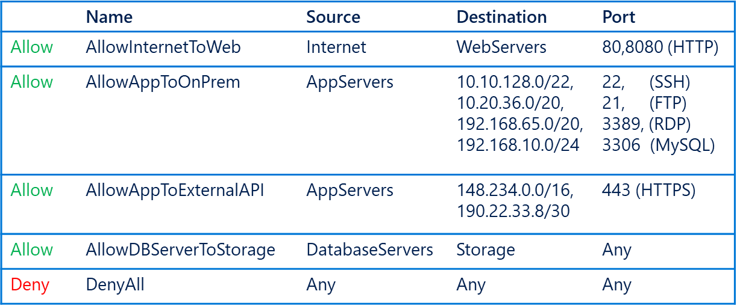
Protecting your application
Simplified Security Group Management
Network Security Groups (NSG)​
IP based network ACL​
Attach: Subnet and NICs​
Service Tags​
Named monikers for Azure service IPs​
SQL, Storage, Traffic Manager supported​​
Application Security Groups (ASG)​
Named monikers for custom grouping of VMs​
Natural expression of application security
From the Internet
WebServers
Within the
VNet
AppServers
DatabaseServers
Within Azure

Slide 52



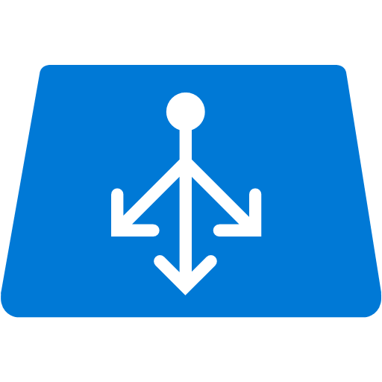


Protecting your application
Securing PaaS Services
Internet
Internet
From the Internet
VNet Service Endpoint
Within the
VNet
Within Azure
PaaS services
Compute - VNet

Slide 53
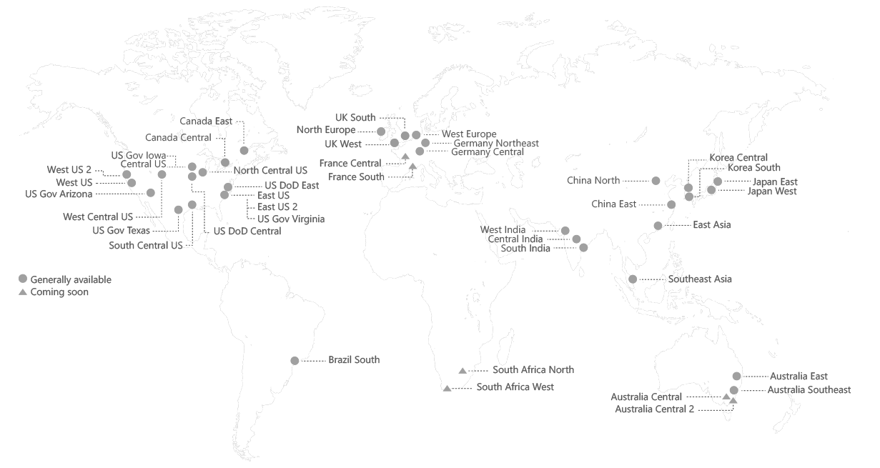
Connectivity
Global VNet Peering
Connectivity
Within Azure
VNet Peering
Azure VNet 1
Azure VNet 2
Scenarios
VNets in different regions can now be peered directly
Simple and quick to configure
Routed through the Azure backbone

